Slide 1
Devops

Slide 2
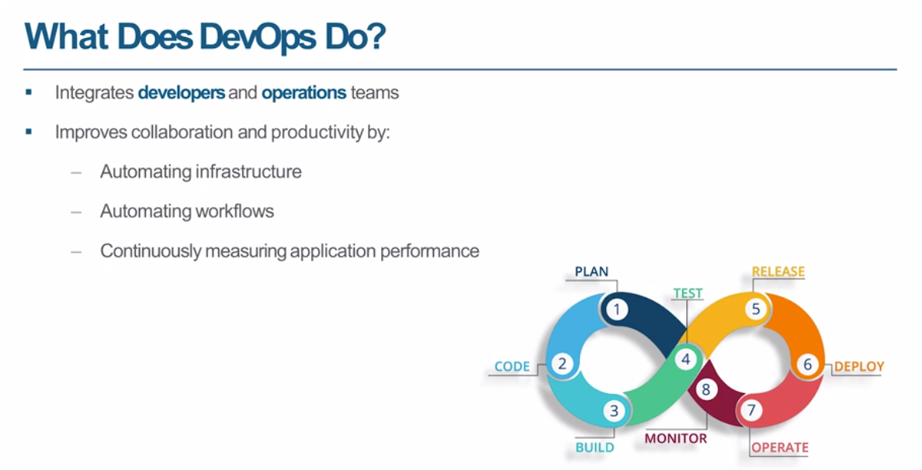

Slide 3
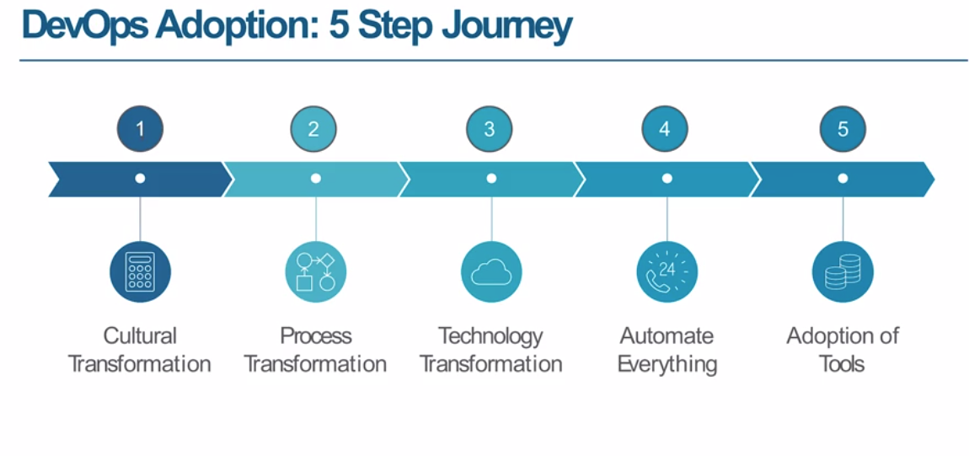

Slide 4
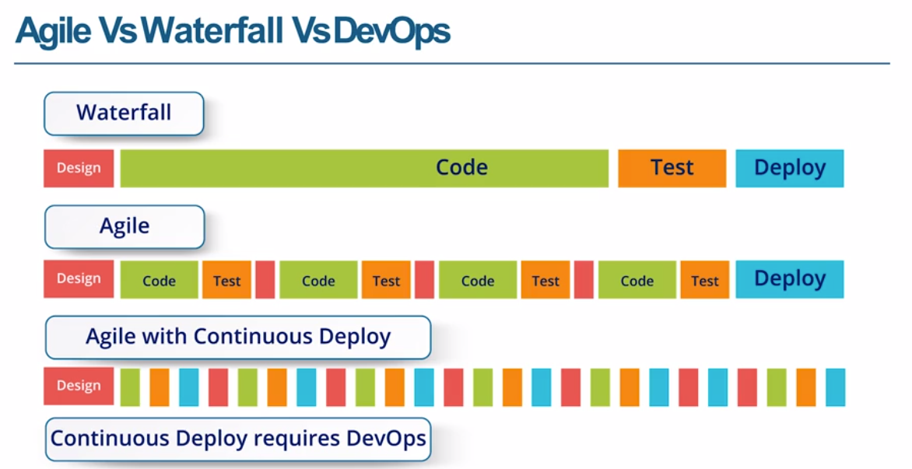

Slide 5
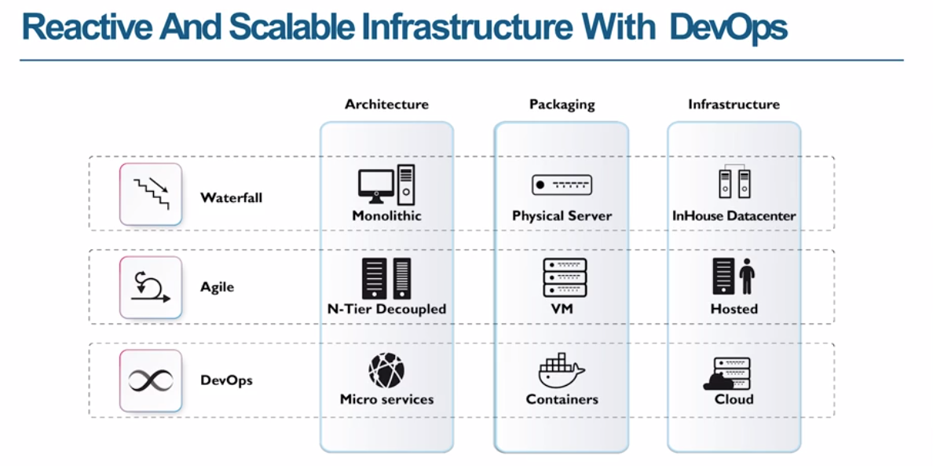

Slide 6
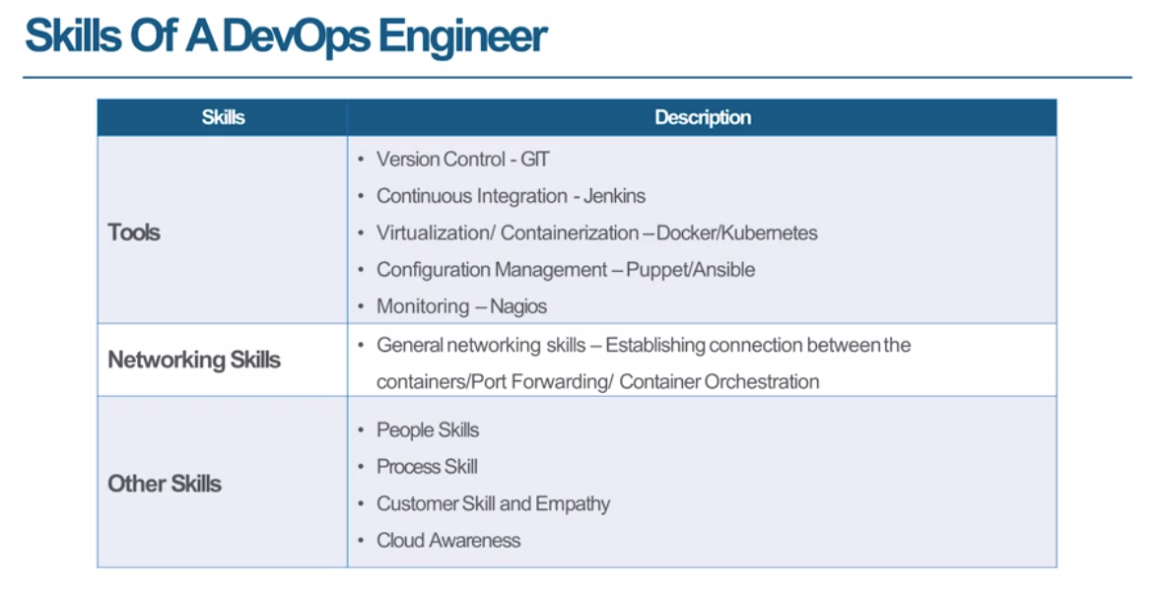

Slide 7
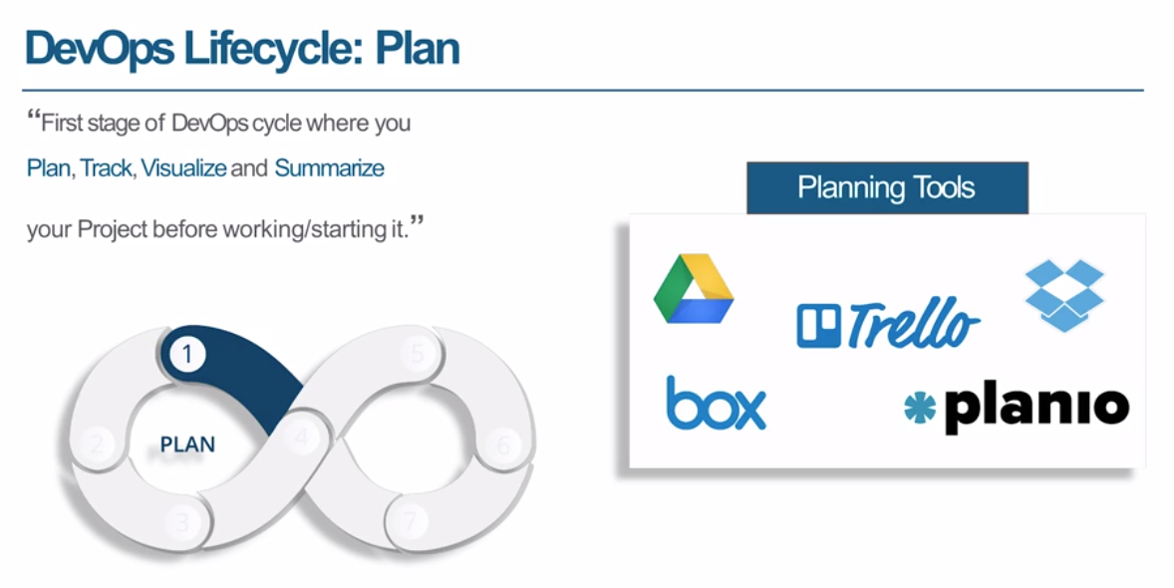

Slide 8
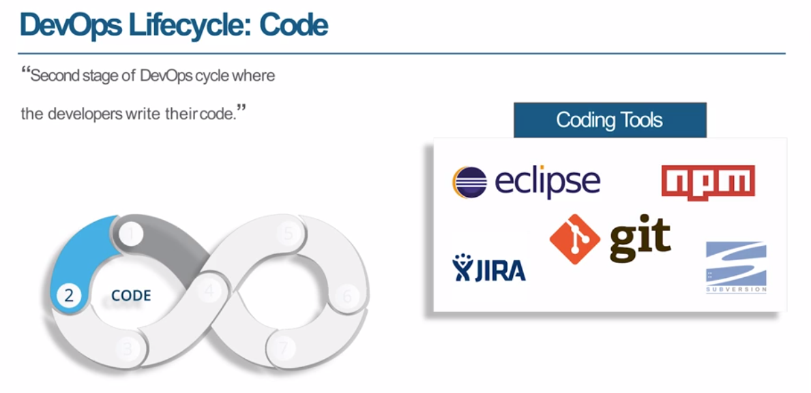

Slide 9
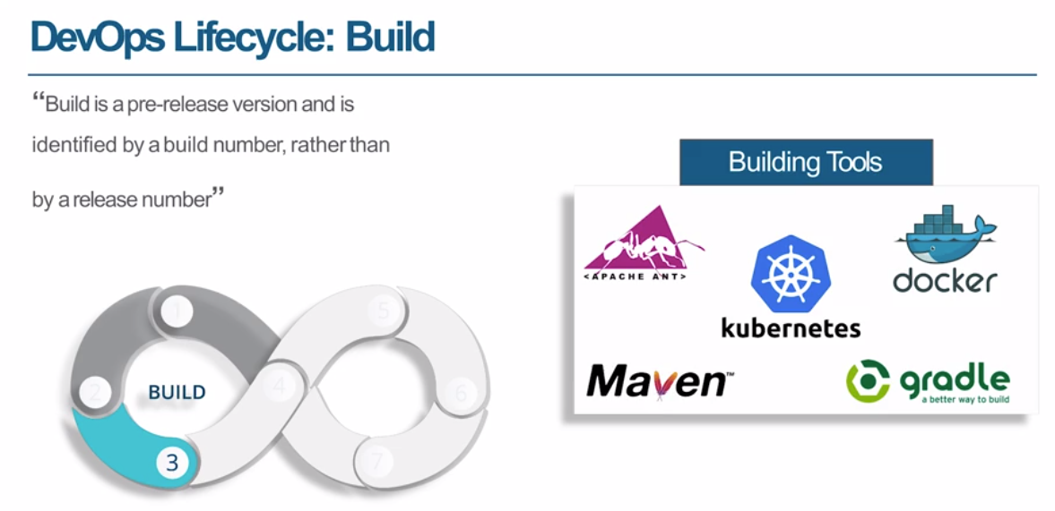

Slide 11
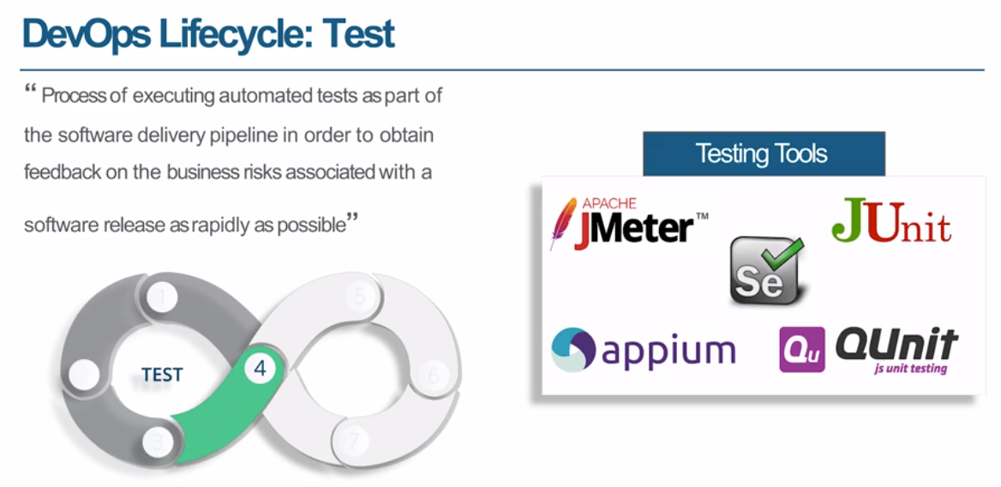

Slide 12

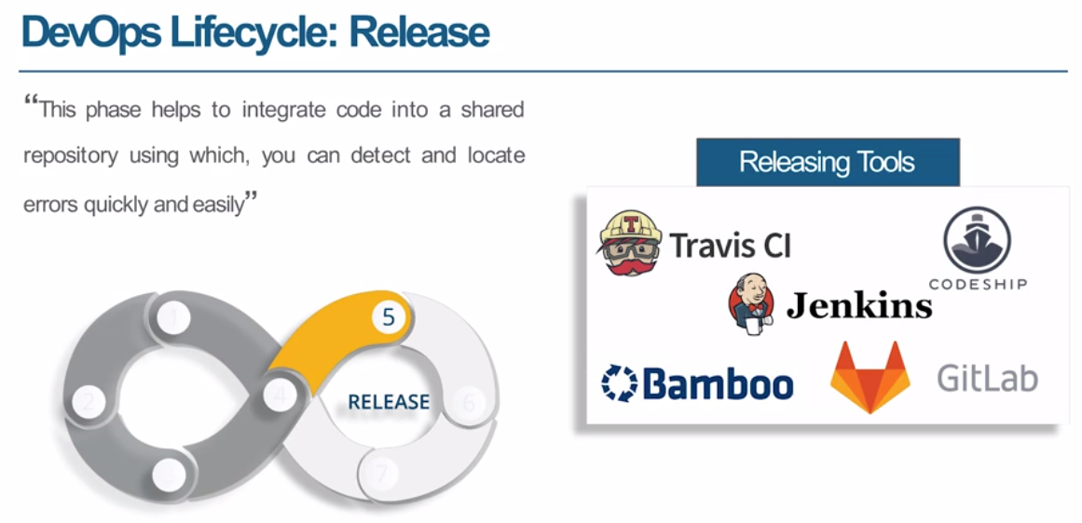

Slide 13
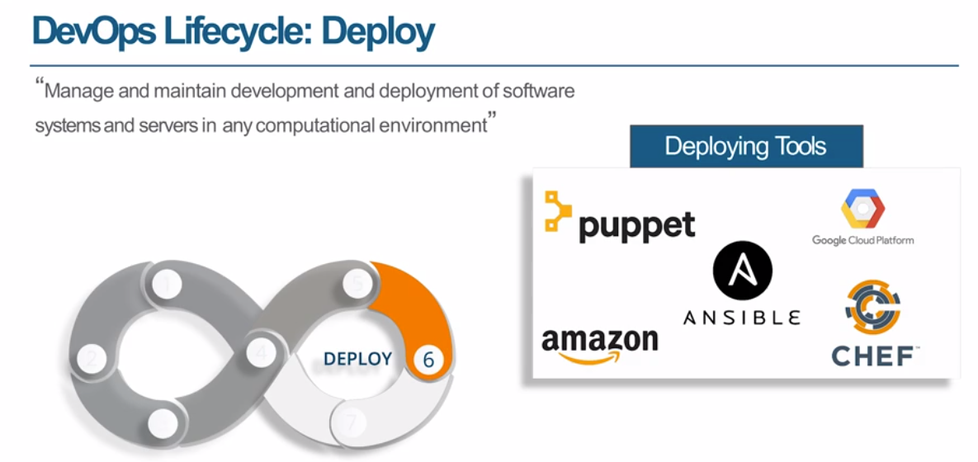

Slide 14
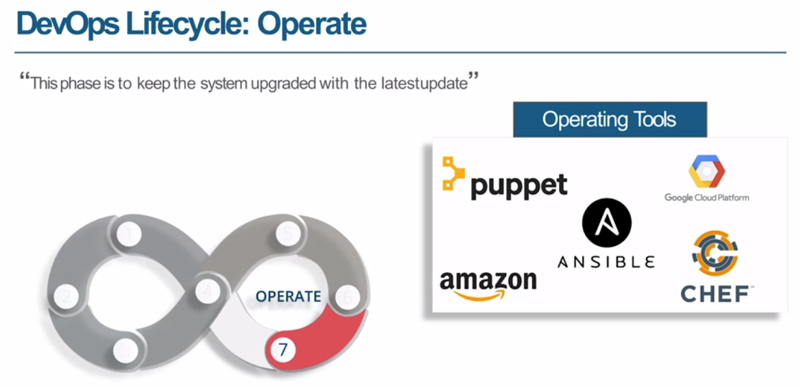

Slide 15
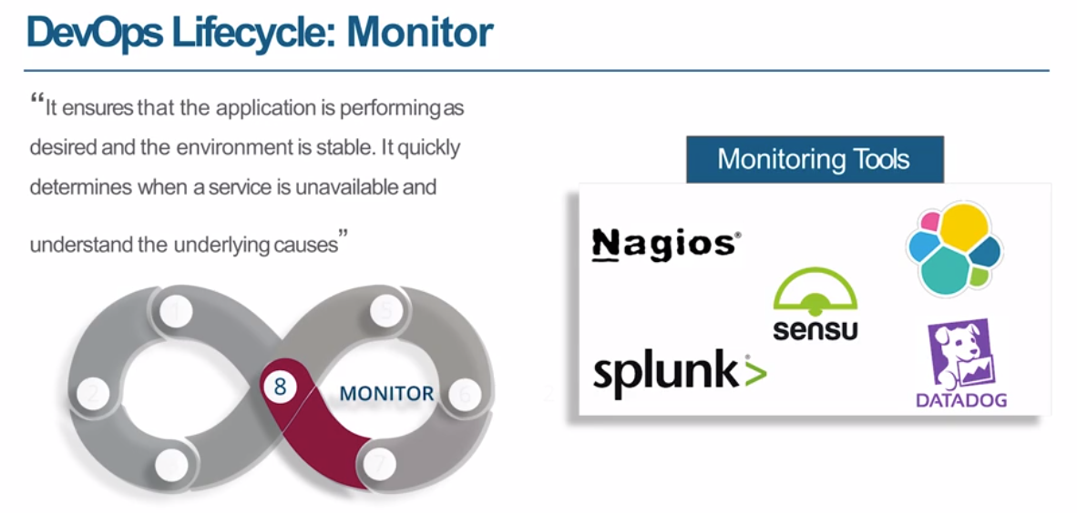

Slide 17
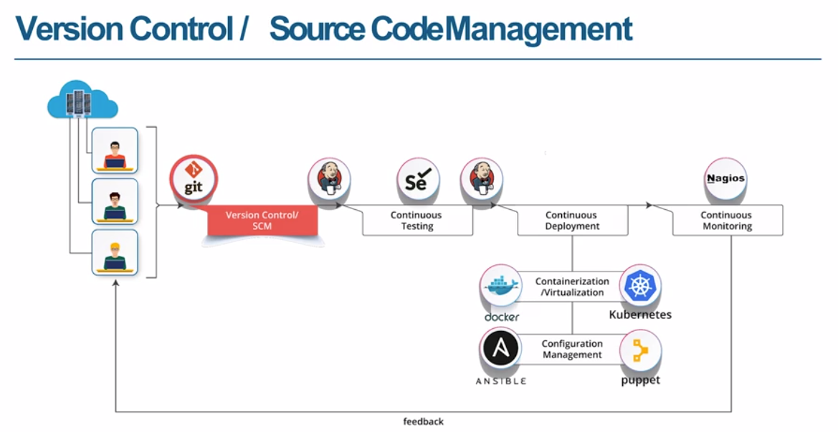

Slide 18
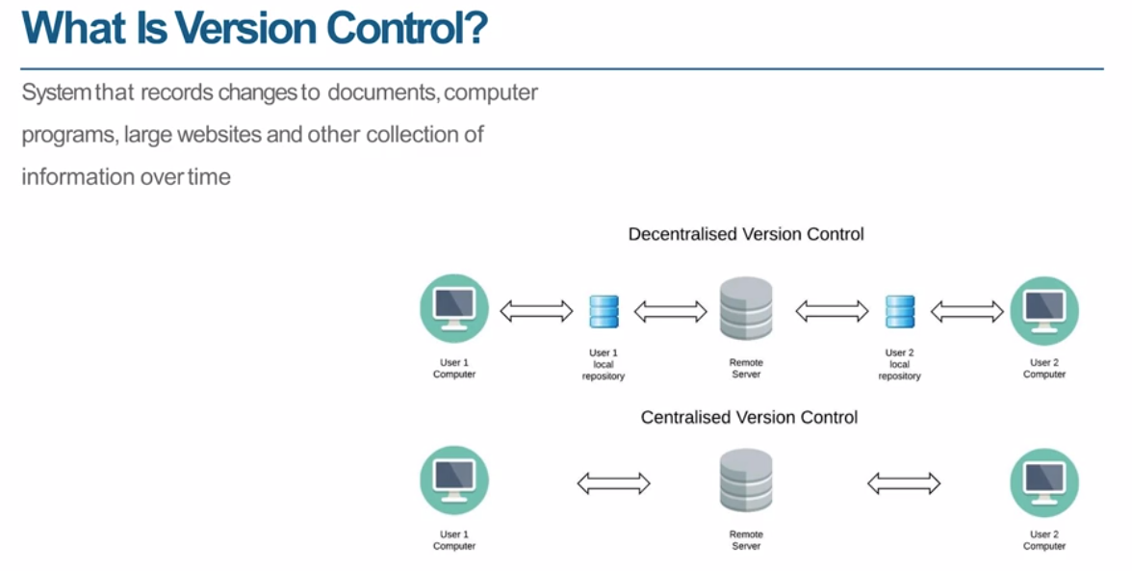

Slide 19
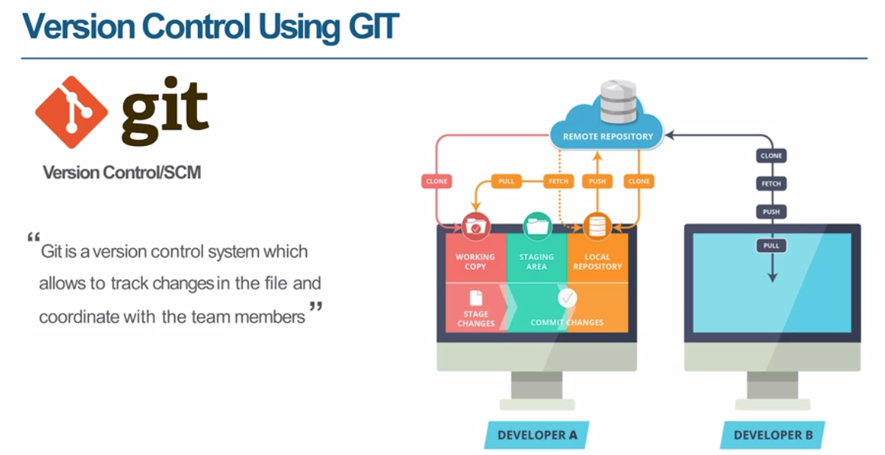

Slide 20
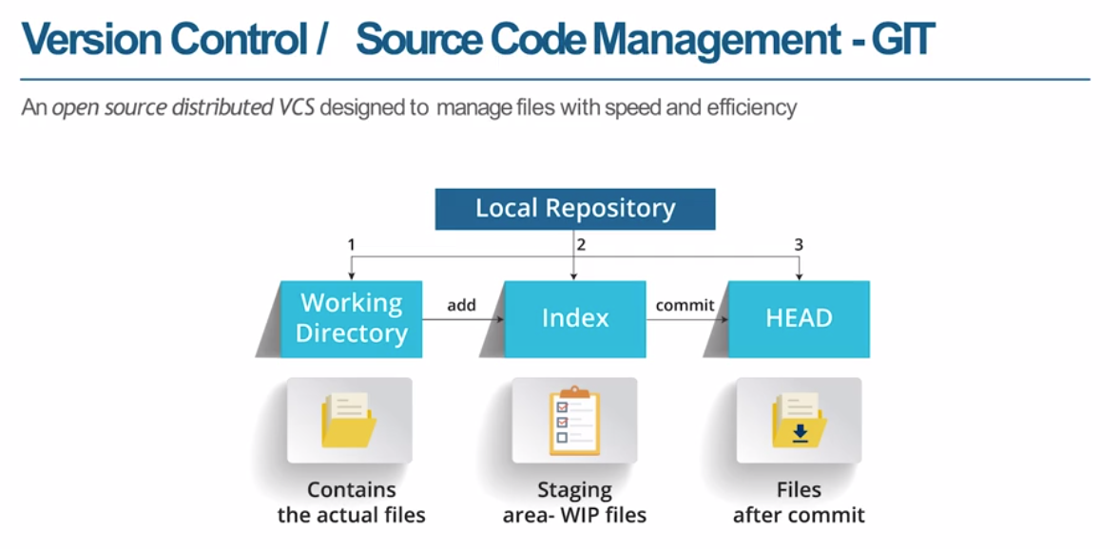

Slide 21
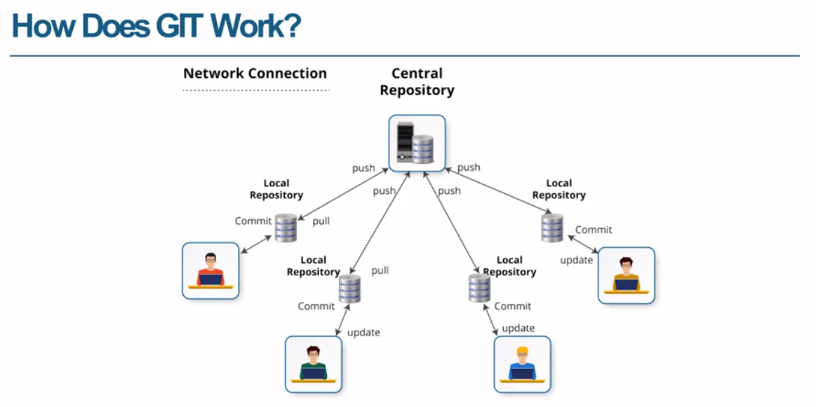

Slide 22
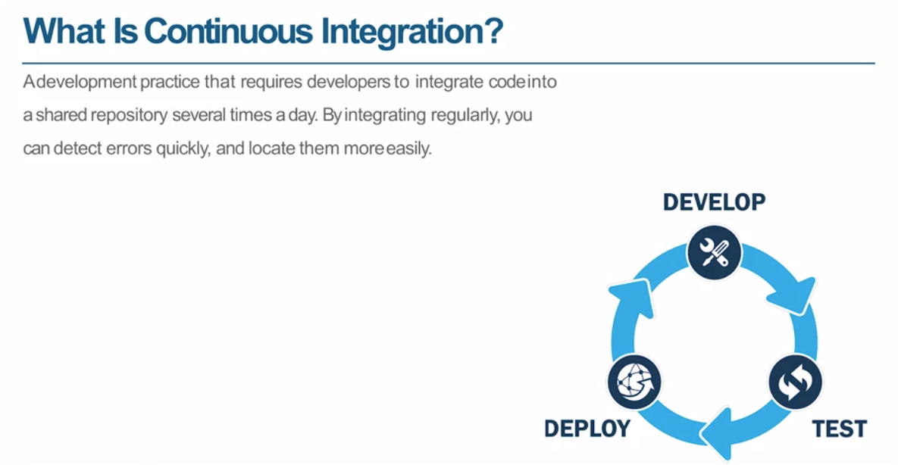

Slide 23
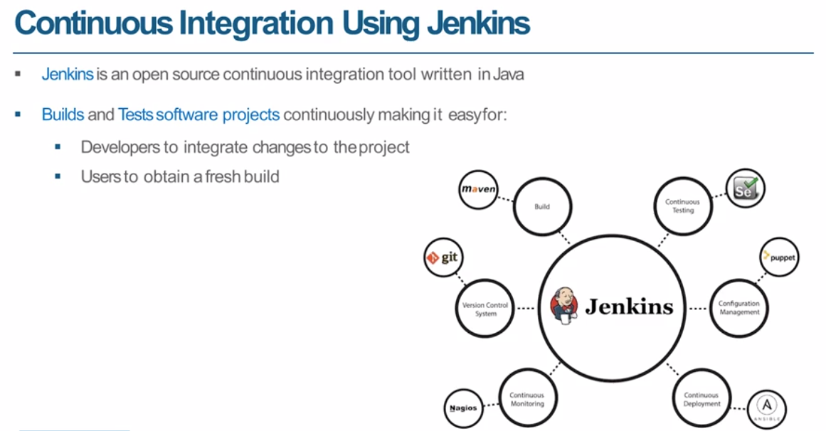

Slide 24
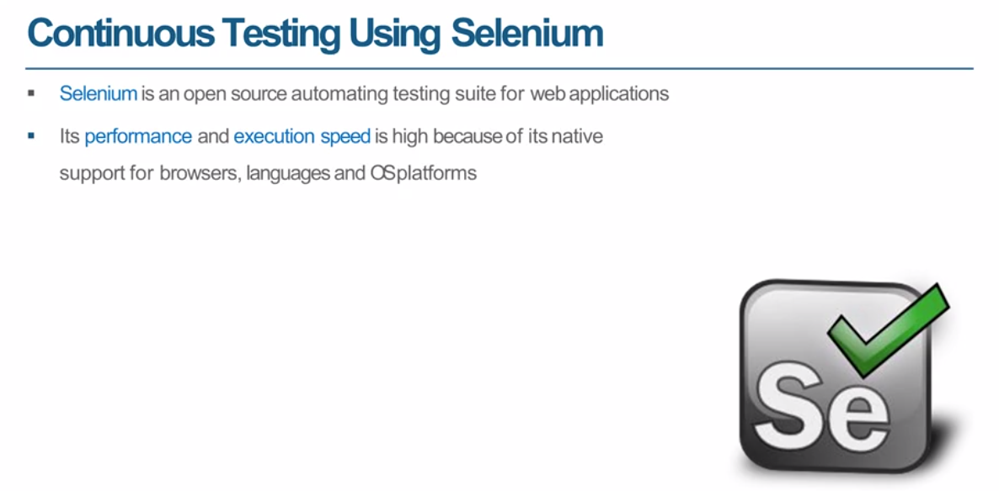

Slide 25
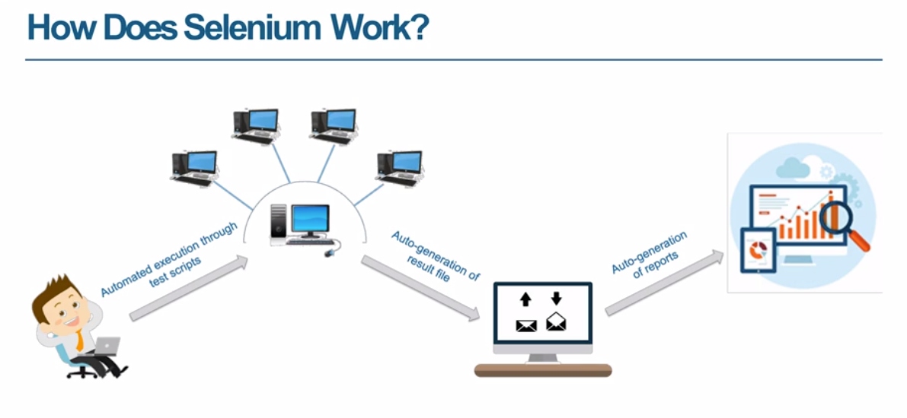

Slide 26
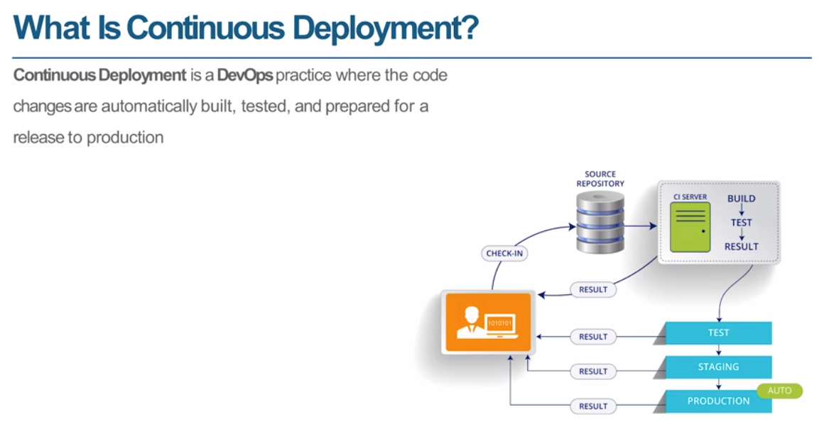

Slide 27
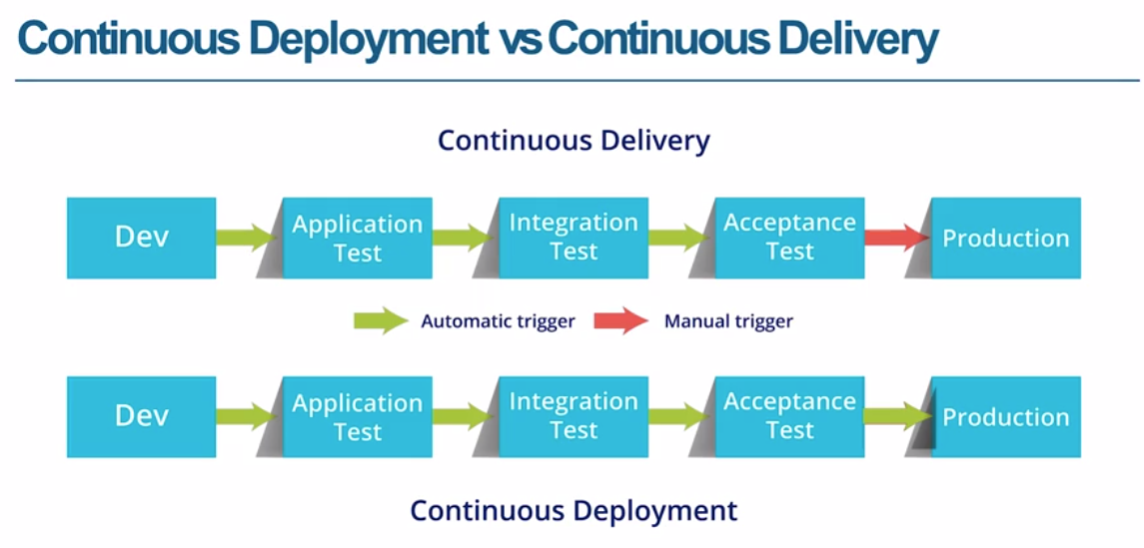

Slide 28
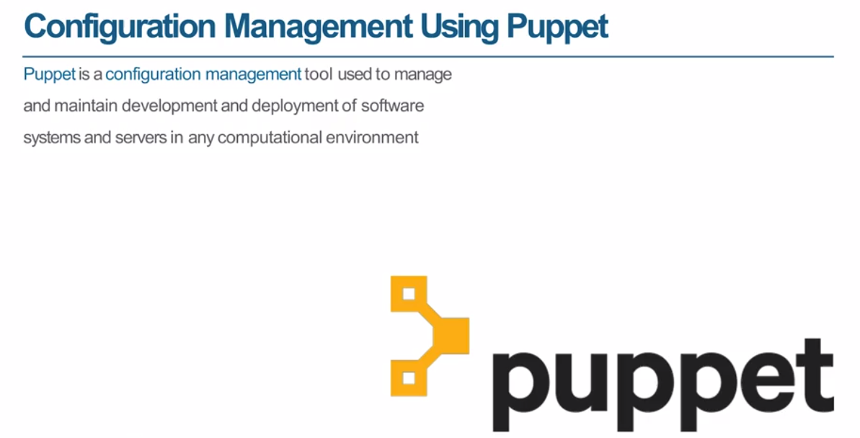

Slide 29
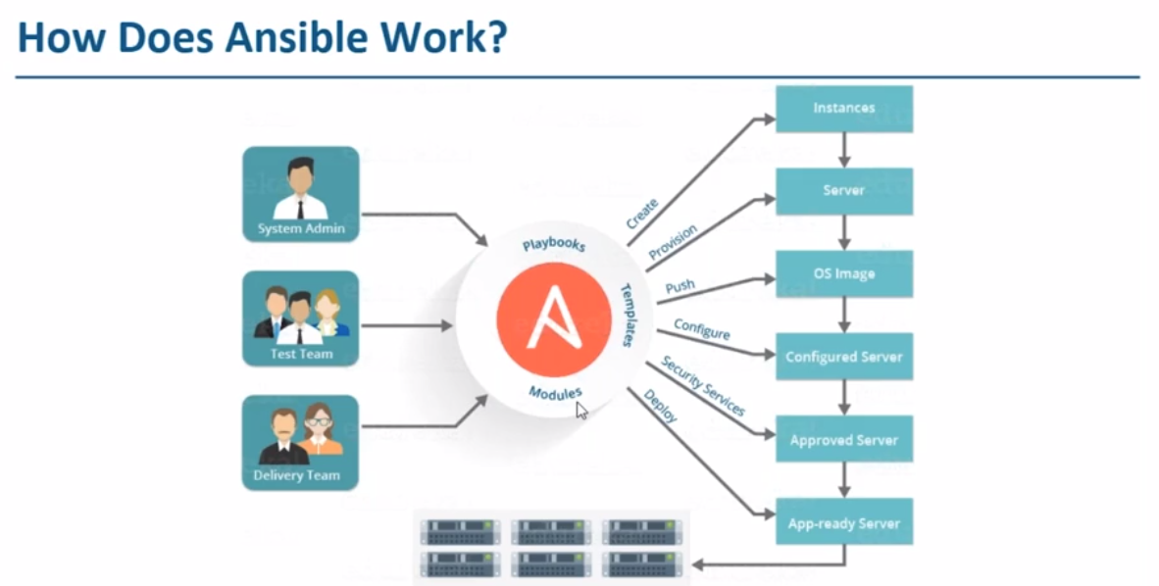

Slide 30
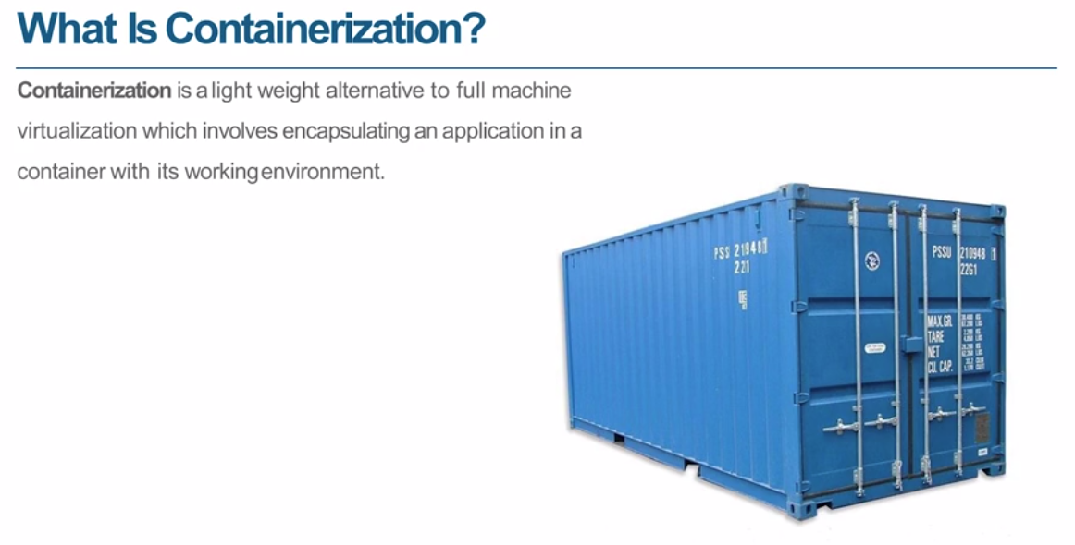

Slide 31
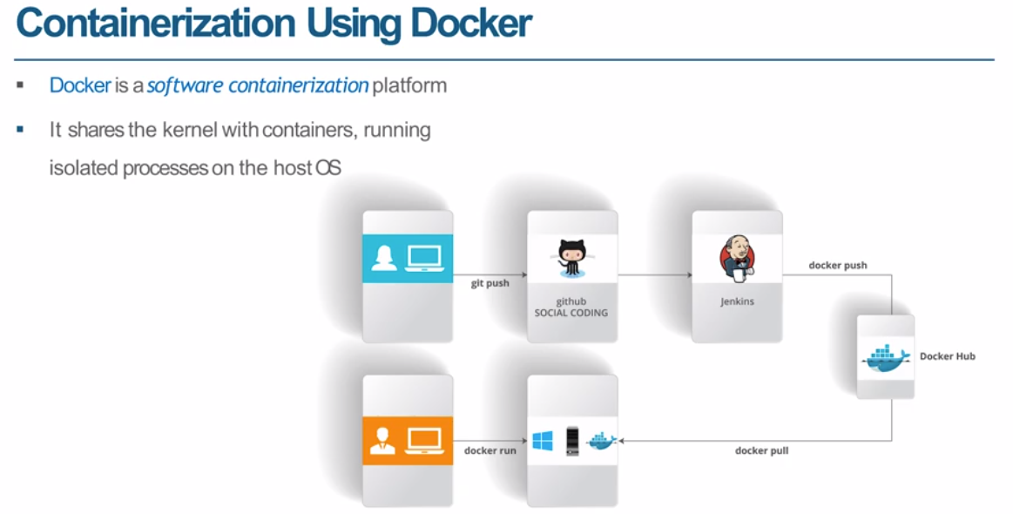

Slide 32
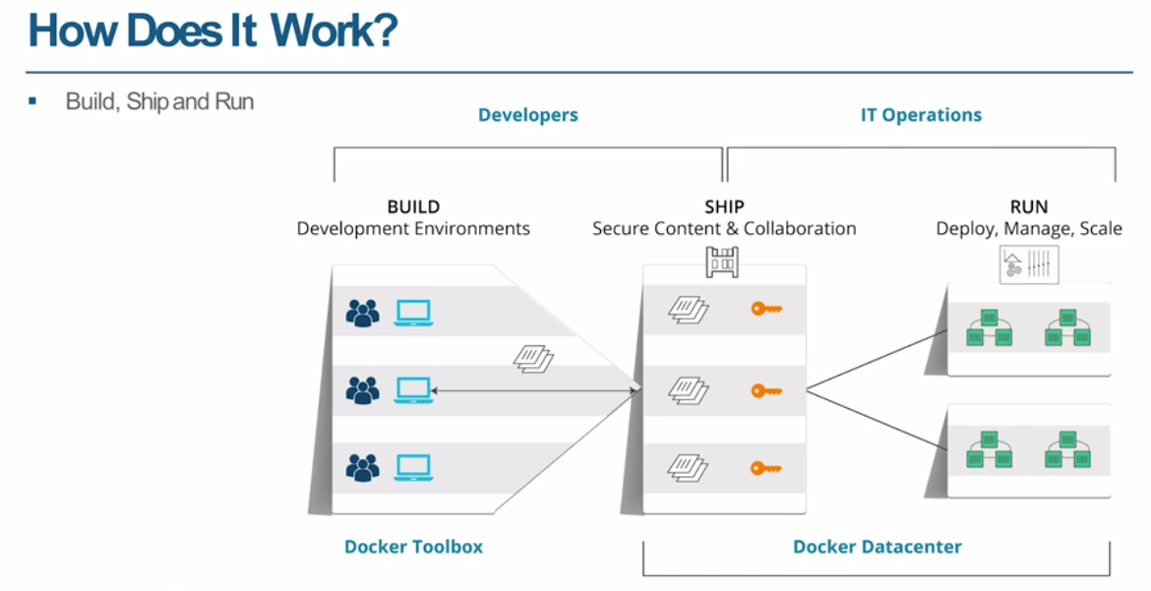

Slide 33
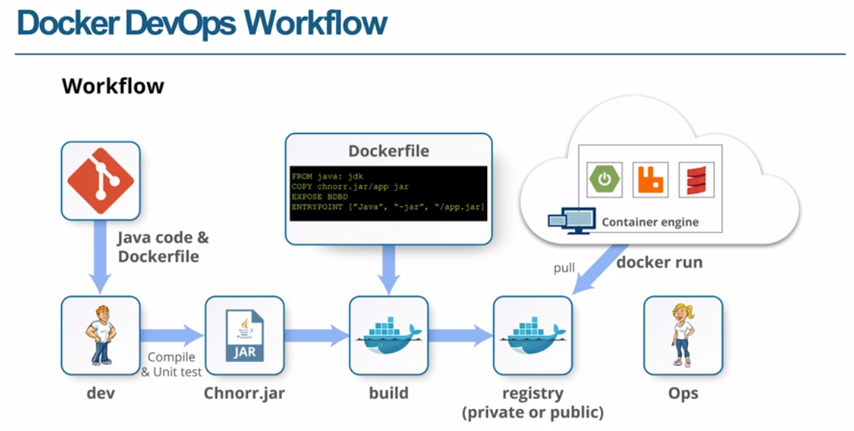

Slide 34
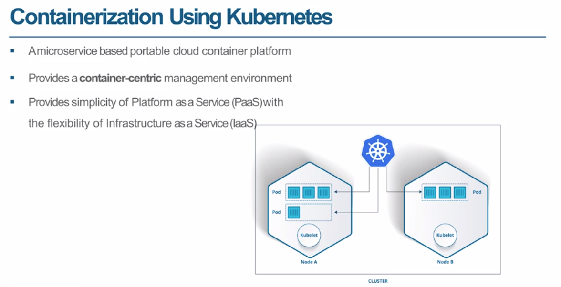

Slide 35
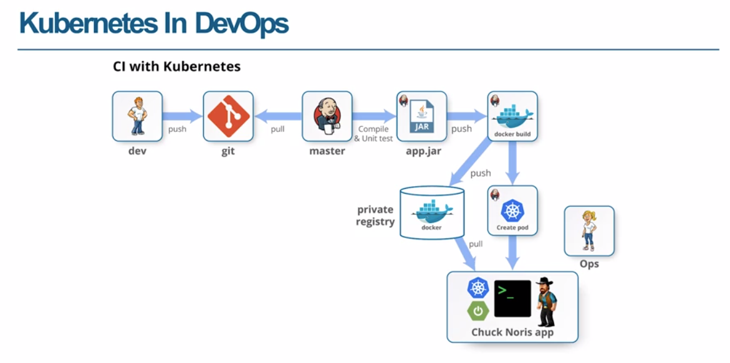

Slide 36
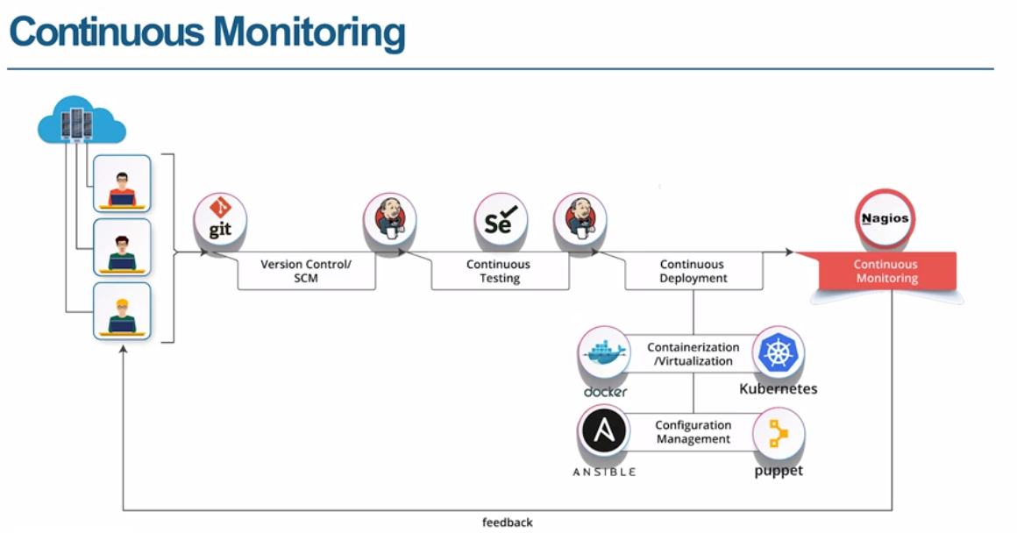

Slide 37
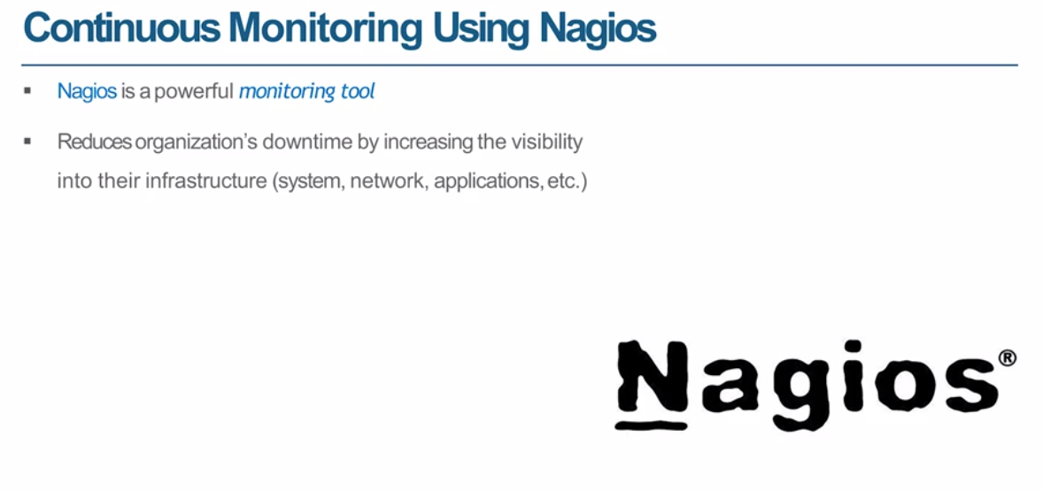

Slide 38
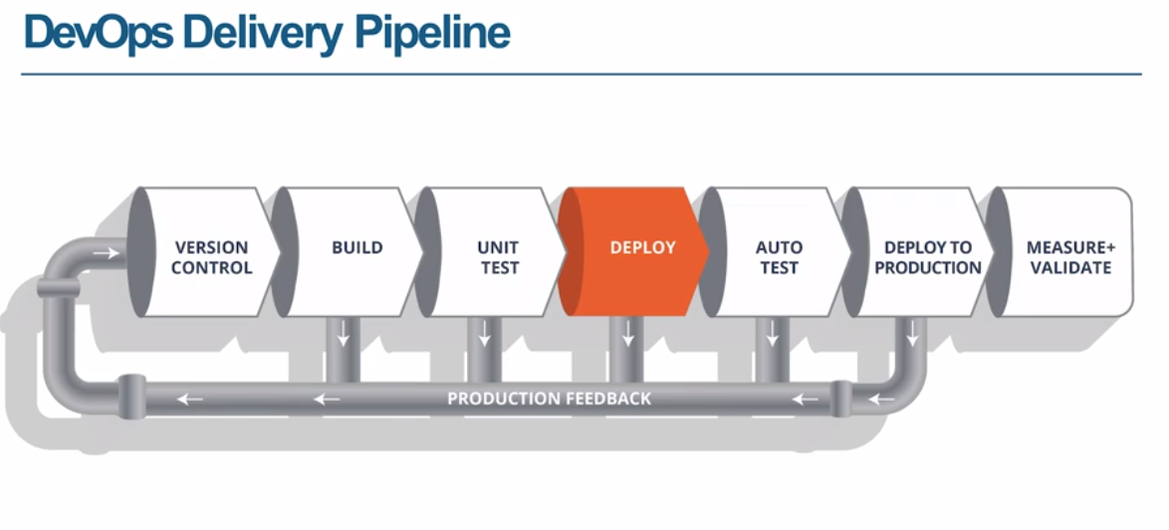

Slide 39
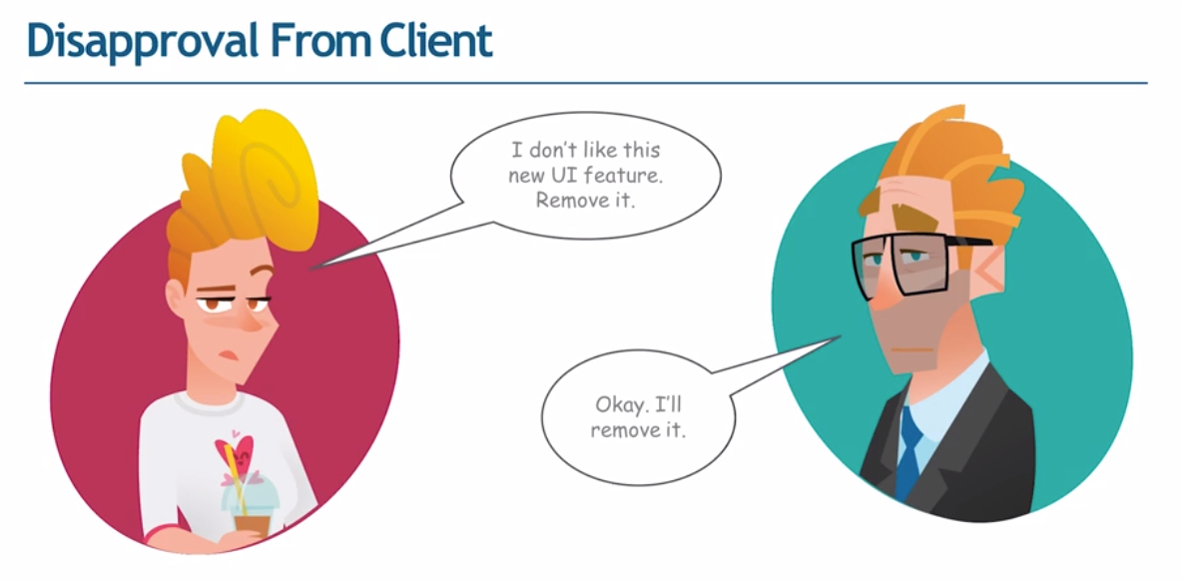

Slide 40
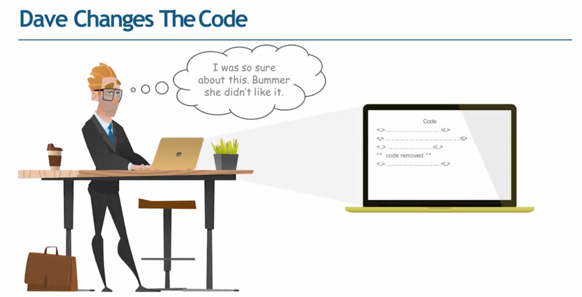

Slide 41
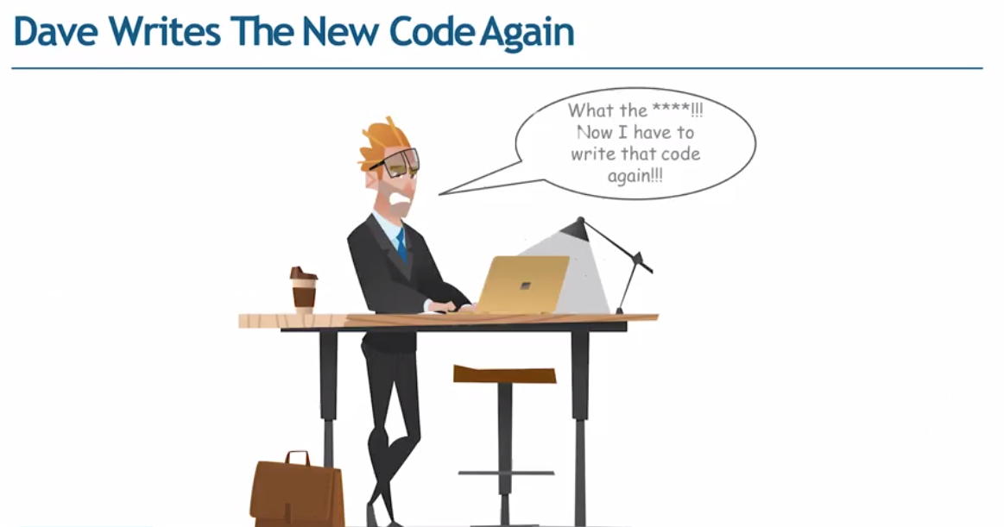

Slide 42
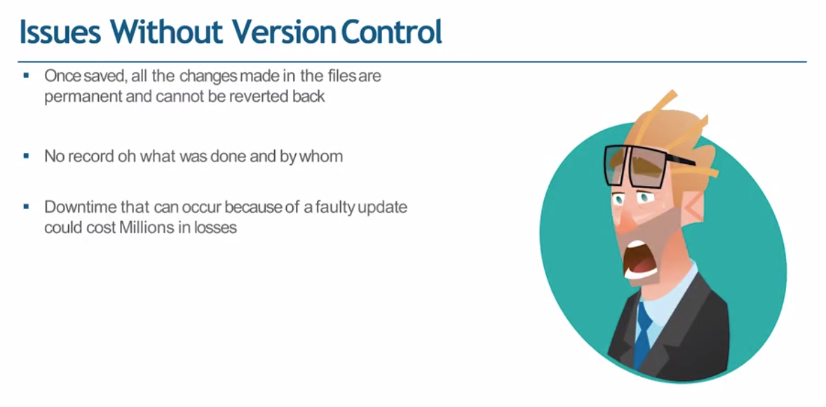

Slide 43
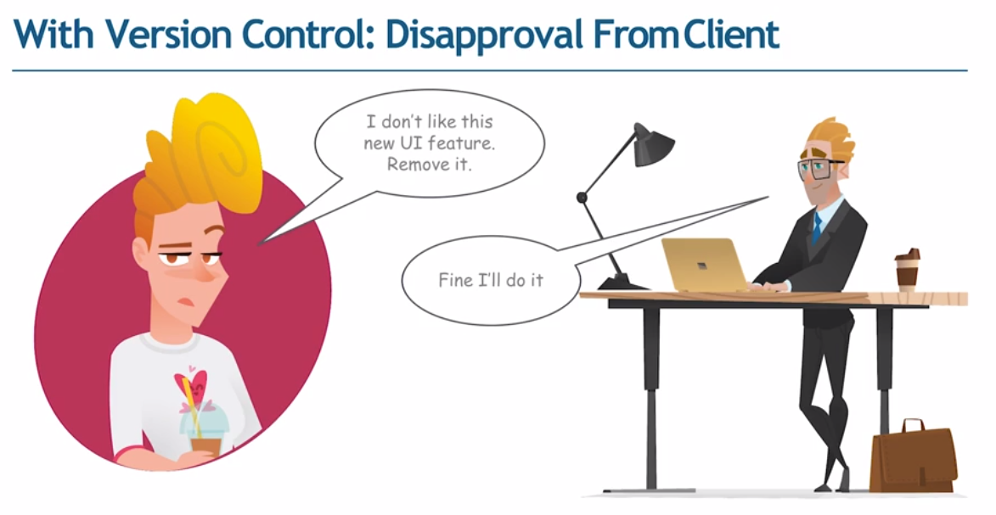

Slide 44
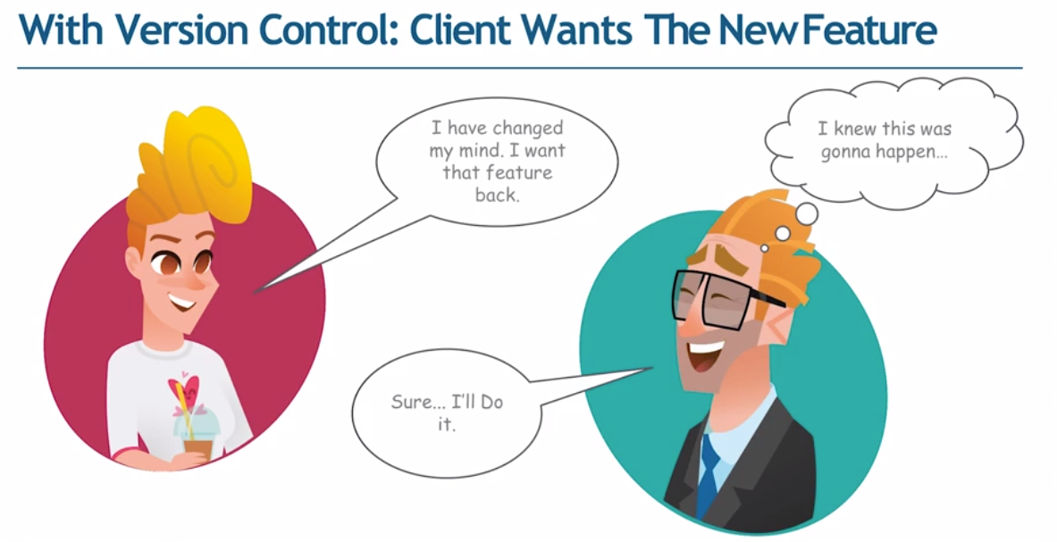

Slide 45
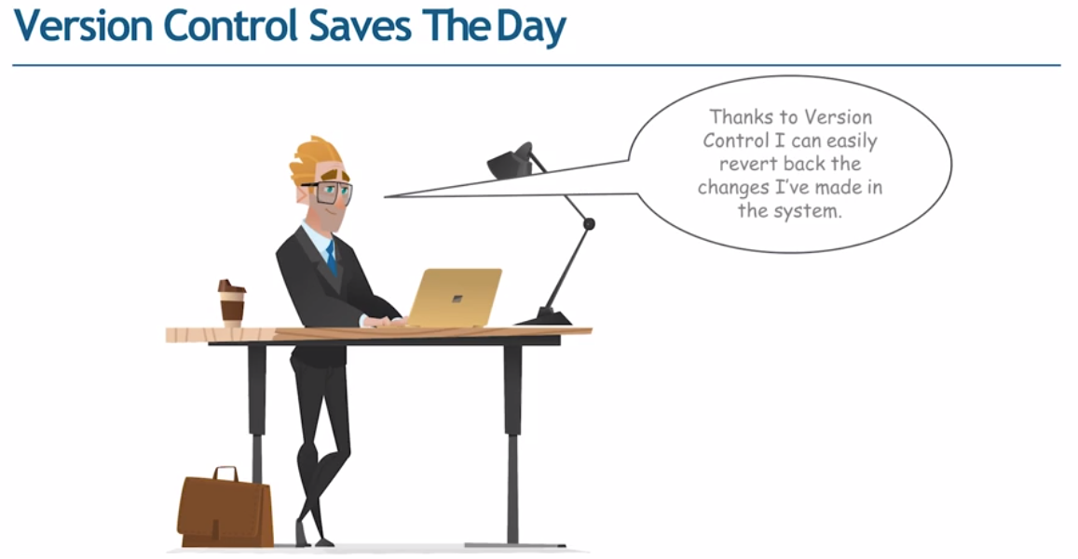

Slide 46
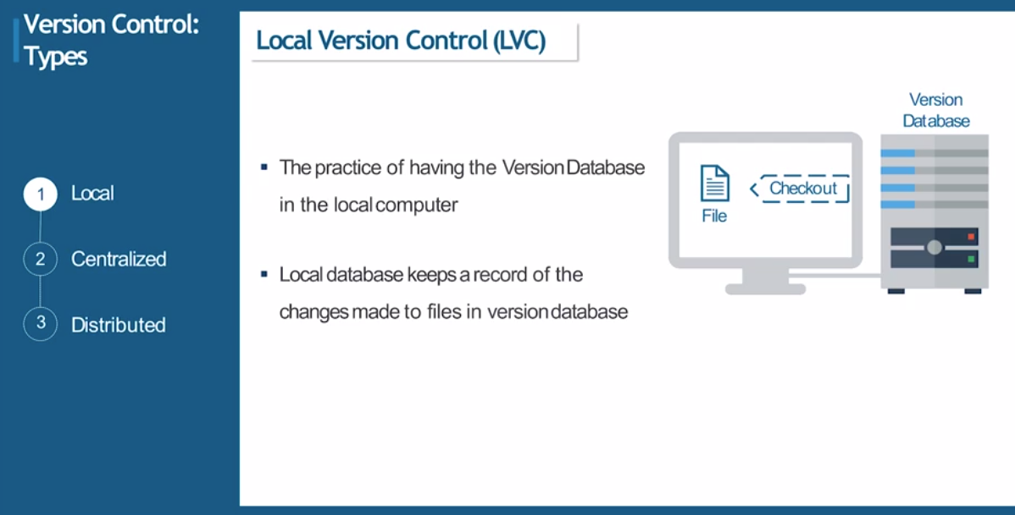

Slide 47
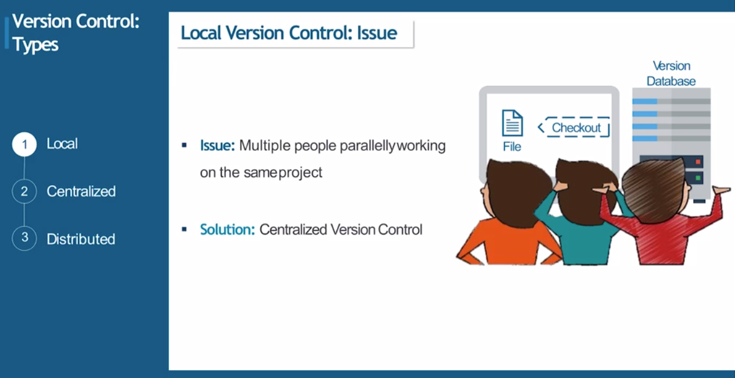

Slide 48
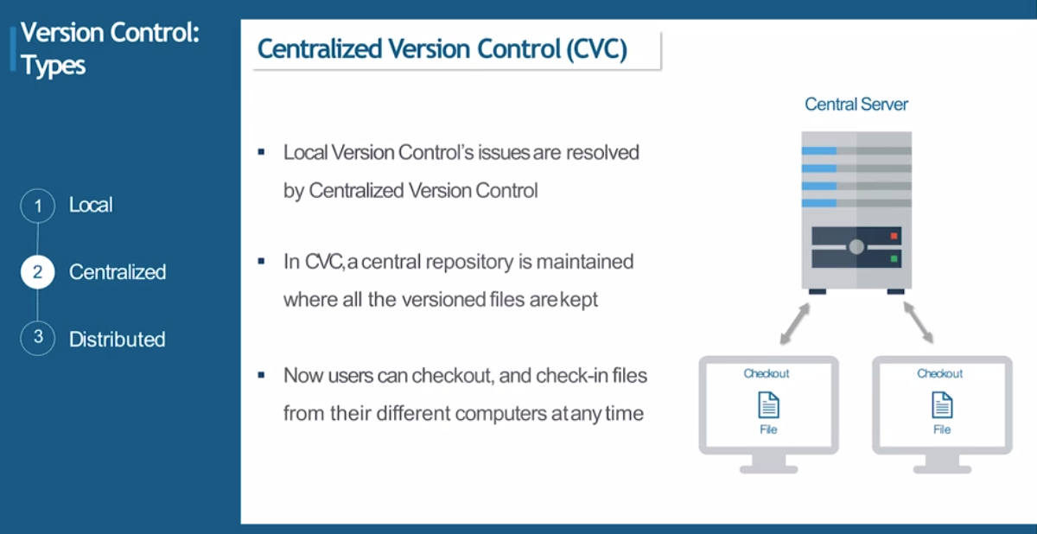

Slide 49
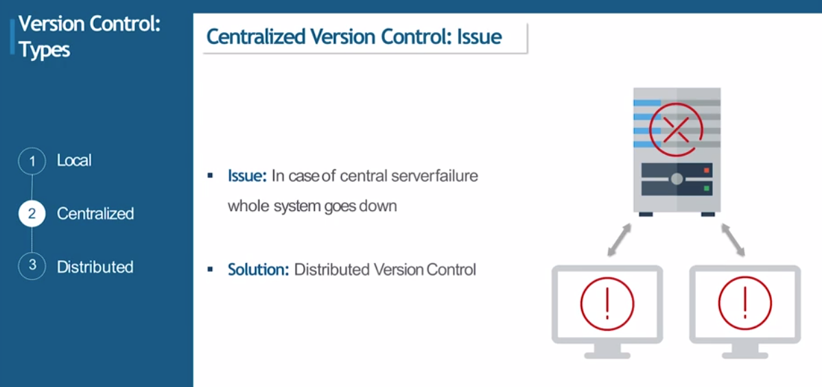

Slide 50
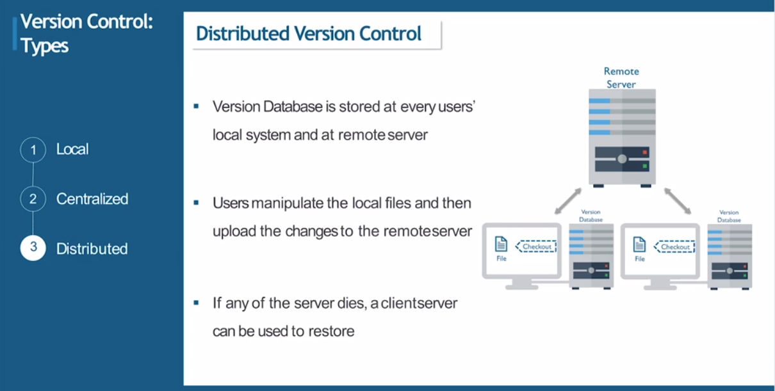

Slide 51
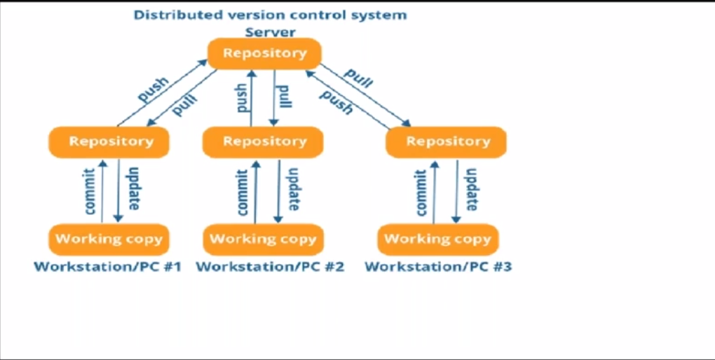

Slide 52
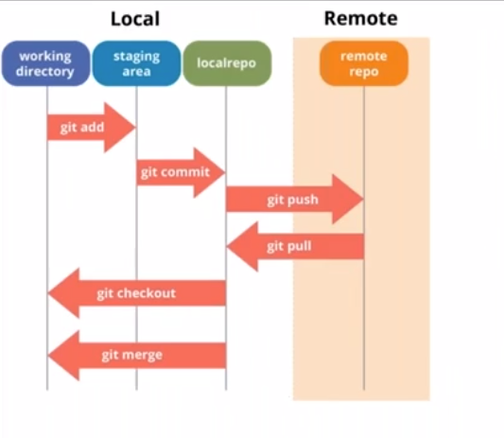

Slide 53
git init
git ls-files
git status
git add filename
git commit -m 'message'

Slide 54
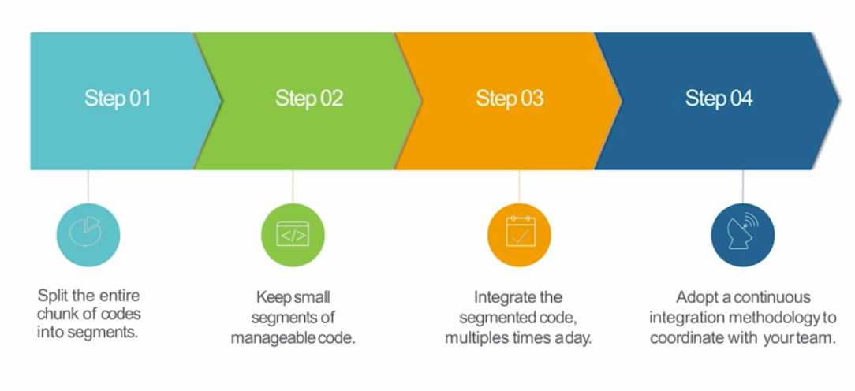

Slide 55


Slide 56


Slide 57


Slide 58


Slide 59


Slide 60


Slide 61


Slide 62


Slide 63


Slide 64


Slide 65


Slide 66
Matrix based security → user will have same permissions across all jobs (readonly, admin etc)
Project based authorization → user will have different permissions across jobs based on the project

Slide 69


Slide 70


Slide 71


Slide 72


Slide 73


Slide 74


Slide 75


Slide 76


Slide 77


Slide 78


Slide 79


Slide 80


Slide 81


Slide 82


Slide 83


Slide 84


Slide 85


Slide 86
Docker
Container management system
Has a powerful toolbox
Docker toolbox → installer to quickly and easily install, setup docker environment in our machine.
Contents of toolbox :
Docker Machine for running docker machine commands
Docker engine for running docker commands
Docker compose for running docker compose commands
Kitematic → Desktop GUI for docker
A shell preconfigured for a docker command line environment

Slide 87

Docker machine → can manage multiple docker hosts
Docker host → A vm or a server where your docker engine/daemon is running
Steps to follow :
Create a VM
Install docker
Run container
Docker engine → part of docker that creates and runs Dockercontainers
It’s the core of docker platform which acts as a lightweight runtime that runs docker containers
Docker engine knows how to talk to the kernel, makes the system calls to create, operate and manage containers, which we don’t have to worry about as users.

Slide 88
Docker Machine
A tool that lets you install docker engine on Virtual hosts and manage hosts with docker machine commands
We can use docker machine to install docker engine on one or more virtual systems
Using docker machine commands we can:
Start, stop, inspect, restart a managed host
Upgrade docker client and daemon
Configure docker client to talk to your host

Slide 89


VM vs Container

Slide 90


Slide 91


Slide 92
Docker compose (docker-compose.yml)→ docker-compose up -d
wordpress:
image: wordpress
links:
- wordpress_db:mysql
ports:
- "7070:80"
wordpress_db:
image : mariadb
environment:
MYSQL_ROOT_PASSWORD: sample
phpadmin:
image: corbinu/docker-phpmyadmin
links:
- wordpress_db:mysql
ports:
- "8181:80"
environment:
MYSQL_USERNAME: root
MYSQL_ROOT_PASSWORD: sample

Slide 93


Slide 94


Slide 95


Slide 96


